Slide 1
DIGITAL PEN
-by Binary Bonbers

Slide 2


Design a pen that gets connected to your PC (or Hand-held device) such that everything written using the pen is made available on the connected device.
You may use ML to convert handwritten content to text or just be made available as a pastable drawing.
The pen should be usable on any surface, be it a tabletop or bulletin board.
The connection could be wired or wireless.
Problem Statement

Slide 3
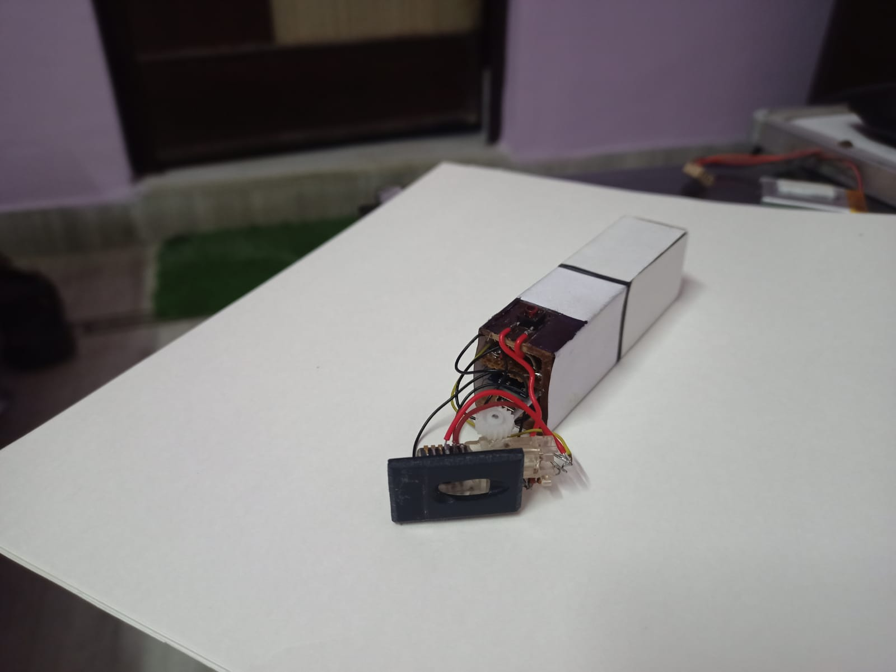
Digital Pen

Slide 4


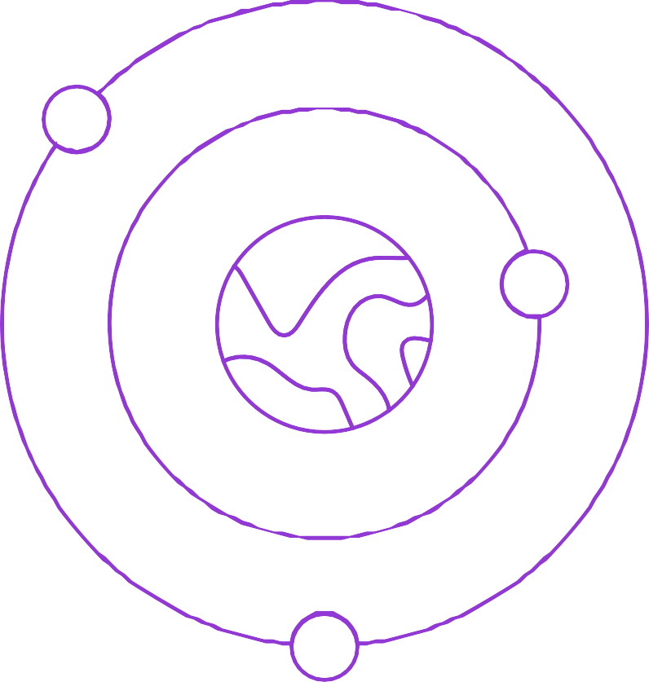


Wireless connectivity
Specifications
Long range transmission
Rechargeable Batteries Real time response Interactive user interface

Slide 5


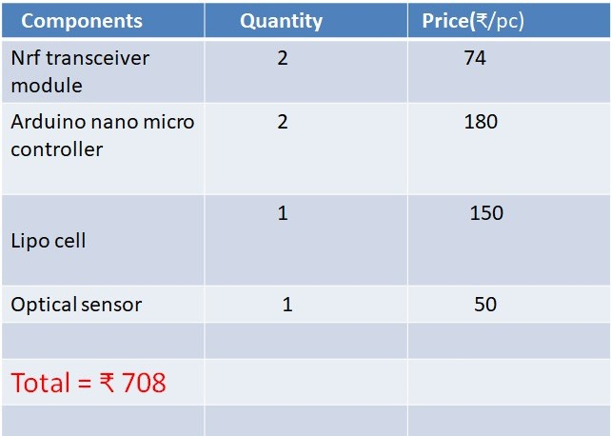
Bill Details

Slide 6
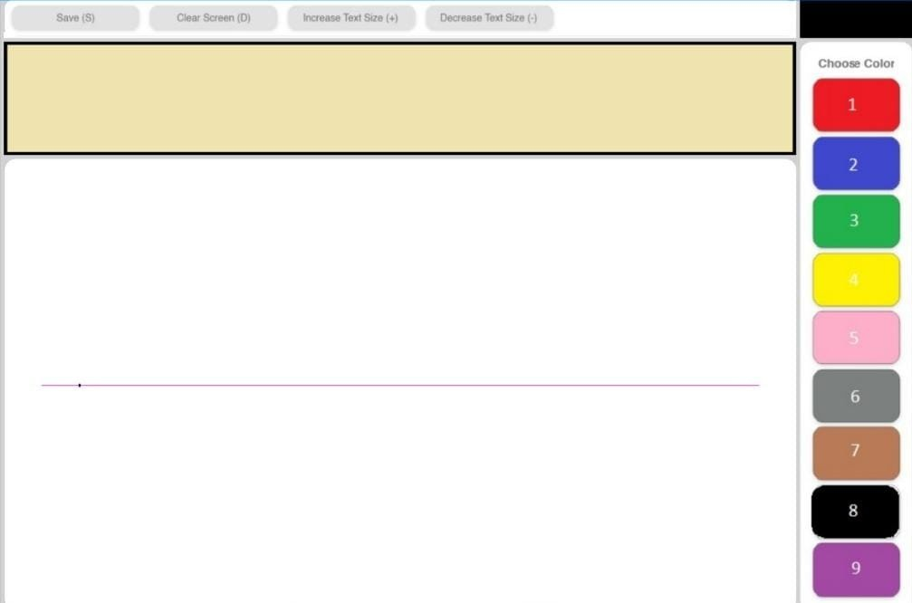

User Interface

Slide 7





Adjustable font-size
Features
Variety of pen colours
Quick save capability
Extra output panel Auto spacing
Adjustable spacing time

Slide 8
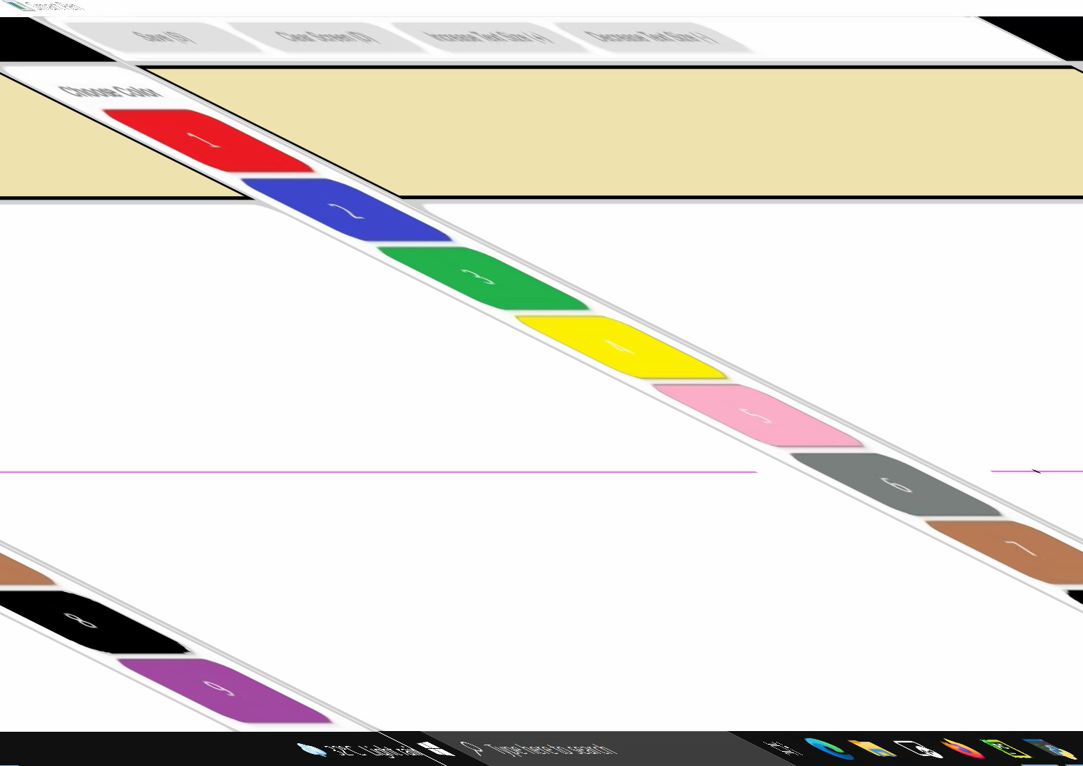
WORKING VIDEO

Slide 9
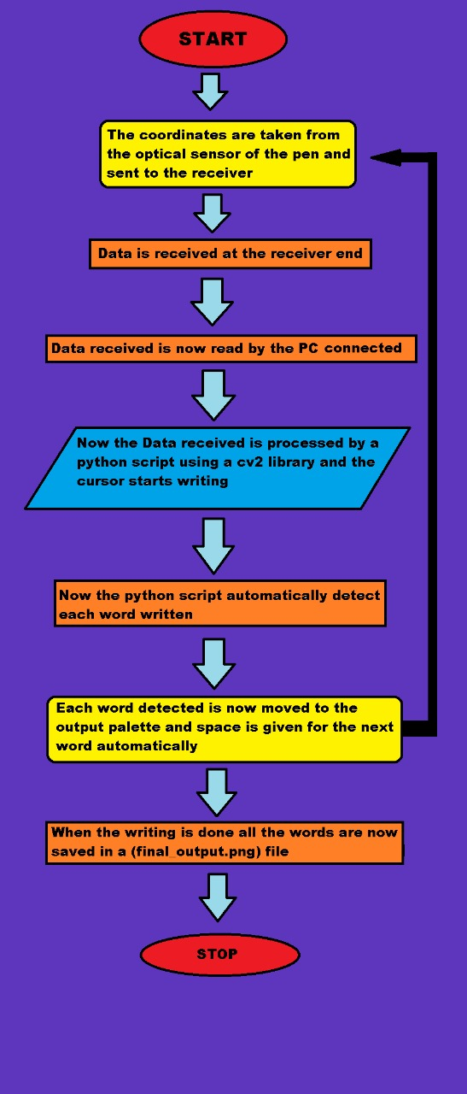
Flowchart

Slide 10
Detecting the X and Y coordinates on the surface
Challenges Faced
Detecting backspace.
Detecting similar symbols like (-,_) distinctively.
Implementing the deletion function
Making a quick response and user driven UI

Slide 11
We have hereby provided a fully functional digital pen capable of writing on any surface.
The output of the writing is visible on the console and can be saved easily.
On exiting the program the user gets a full png image of all the editing he has done in the save directory.
Conclusion
Various techiniques have been implemented to provide a smooth user experience.
The feature of pen up and pen down is implemented which aims to give user the freedom to stop printing on the screen when he requires so.
Link: Optical-Pen

